Slide 1

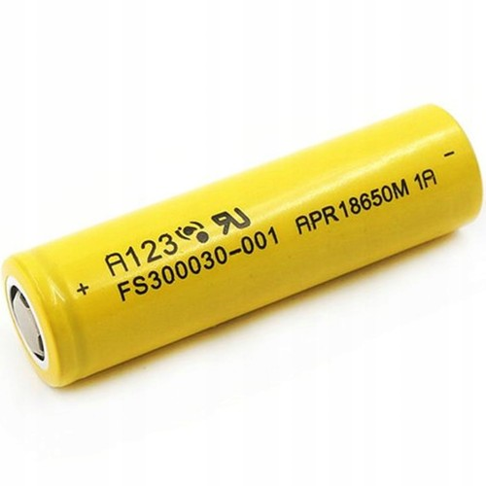

A Sequence-to-Sequence (Seq2Seq) Network for Estimating the State of Charge of Li-Ion EV Batteries
S. Meikandadevan
124150028
II M.Sc., Data Science
School of Arts, Sciences, Humanities and Education (SASHE)
Guided by,
Dr. Manivannan .R
Department of Mathematics,
SASHE.

Slide 2
Motivation
Rechargeable energy storage devices, such as Li- Ion batteries(LIB), have become increasingly popular because of their extended life cycle, high energy density, and light-weight construction for a variety of industrial applications, especially Electric Vehicles (EVs).
Despite its high power and energy density, it is vital for a Battery Management System (BMS) to ensure a safe, efficient, and stable operating state in order to decrease overdesign costs and improve battery performance.
Fig 1 : The Importance of LIB
ZBFB - Zinc–Bromine Flow Battery, VRFB - Vanadium Redox Flow Battery, Na-S - Sodium–Sulfur Battery

Slide 3
Specifications of a Lithium-Ion Battery
Battery chemistry and its specifications | LFP | NCA | NMC
Nominal Voltage (V) | 3.3 V | 3.6 V | 3.6 V
Nominal Capacity (Ah) | 1.1 Ah | 3.2 Ah | 3 Ah
Upper Cut-Off Voltage | 3.6 V | 4.2 V | 4.2 V
Lower Cut-Off Voltage | 2.0 V | 2.5 V | 2.0 V
Temperature (Deg C) | -30 to 60 ˚C | 0 to 45 ˚C | -5 to 50 ˚C
Nominal Mass (g) | 39 g | 48.5 g | 47 g
Table 1 : Different types of LIB
LFP - Lithium Iron Phosphate | NCA - Lithium Nickel Cobalt Aluminium Oxide | NMC - Lithium Nickel Manganese Cobalt Oxide

Slide 4
The Relationships between various Battery States
Thermal State
(Intermediate)
Electrical State
(Small)
Aging State
(Large)
Timescales – Small, Large & Intermediate
Temperature
SOT
SOC
SOP/SOF
SOE
SOH
RUL
SOC – State-of-Charge
Temperature
Battery Parameters
SOP/SOF – State-of-Power/ State-of-Function
Constraint
Quantitative Relationship
Capacity
SOE – State-of-Energy
Heat
Generation
Integration
Operating Conditions
SOH – State-of-Health
RUL – Remaining Useful Lifetime
Battery Parameters
Fig 2 : Battery States

Slide 5
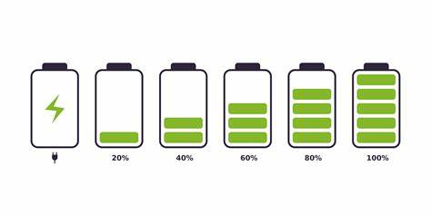
Problem Statement
Our objective is to estimate and predict the SOC of the A123 18650 LIB and to achieve more reliability than existing methods comparatively.
To develop an Graphical User Interface(GUI) for predicting the SOC with respect to voltage, current and temperature.
Fig 3 : State-of-Charge

Slide 6
Various Models Proposed in the Literature
Electrical Equivalent Circuit Model
Electrochemical Impendence Model
Data Driven Model
Electro Thermal Model
Fig 4 : Literature Models
Why Data Driven Model ?
A Data Driven Model is an approach that relies on analyzing large amount of data to make informed decisions and prediction.
Historic Data
Algorithm
Data Driven Insights
Fig 5 : Data Driven Model workflow

Slide 7
Data Driven Model
Data Driven SOC Estimation Methods
Classification & Regression
Support Vector Machine
Random Forecast
Fuzzy Rule Based
Adaptive Neuro Fuzzy Inference System
Fuzzy Logic
Probabilistic
Gaussian Process Regression
Deep Belief Network
Recurrent Neural Network
Non Linear Autoregression Exogenous Inputs
Long Short Term Memory
Gated Recurrent Unit
Feed Forward Neural Network
Back Propagation Neural Networks
Radial Bias Function Neural Network
Extreme Learning Machines
Wavelet Neural Networks
Deep Feed Forward Neural Networks
Hybrid Algorithms
Hybrid Optimization Based Algorithm
Hybrid Deep Learning Algorithm
Genetic Algorithm
Feed Forward Long Short Term Memory
Fig 6 : D-D Models for SOC estimation available in the literature

Slide 8
Literature Survey
Paper Title | Authors | Algorithms/ Methods | Metrics | Year | Journal Name
A multi-variable multi-step Seq2seq networks for the state of charge estimation of lithium-ion battery [1] | Yufeng Huang , Jian Sun , Lei Xu | LSTM based Seq2Seq [1] | RMSE,MAE,MAPE | 2023 | Case Studies in Thermal Engineering
State-of-charge estimation for lithium-ion batteries based on attentional sequence-to-sequence architecture [2] | Yong Tian , Rucong Lai , Xiaoyu Li , Jindong Tian | LSTM based Seq2Seq [2] | RMSE,MAE | 2023 | Journal of Energy Storage
State-of-Charge Estimation of Lithium-Ion Batteries via Long Short-Term Memory Network [3] | Fangfang Yang, Xiangbao Song, Fan Xu, Kwok-Leung Tsui | LSTM [3] | RMSE,MAE | 2019 | IEEE Xplore
A Comparative Study on Open Circuit Voltage Models for Lithium-ion Batteries [4] | Quan‑Qing Yu1 , Rui Xiong1, Le‑Yi Wang2 and Cheng Lin | Low-Current OCV Test, MATLAB curve fitting toolbox [4] | RMSE | 2018 | Chinese Journal of Mechanical Engineering
A review of machine learning state-of-charge and state-of-health estimation algorithms for lithium-ion batteries [5] | Zhong Ren, Changqing Du | Machine learning & Deep learning algorithms [5] | RMSE,MAE,MAPE | 2023 | Energy Reports
Table 2 : Literature Survey [1-5]

Slide 9
About the Base Paper
PAPER TITLE : A multi-variable multi-step Seq2seq networks for the state of charge estimation of lithium-ion battery.
AUTHORS : Yufeng Huang , Jian Sun , Lei Xu.
JOURNAL NAME : Case Studies in Thermal Engineering.
PUBLICATION YEAR : 2023.
ABSTRACT AND INDEXING : Science Citation Index Expanded, Web of Science, Directory of Open Access Journals (DOAJ), INSPEC.
IMPACT FACTOR : 6.8
CITE SCORE : 7.2

Slide 10


Temperature Profile
Fig 7 : World Annual Temperature Map
Fig 8 : Indian Temperature Map

Slide 11
Dataset Description
The data set was provided by the Center for Advanced Life Cycle Engineering (CALCE).
Li-ion A123-18650 battery is run through two different profiles (low current and dynamic) at temperatures ranging from 0°C to 50°C with an interval of 10°C.
Subjects | Values (units)
Battery Name | A123 - 18650
Battery Chemistry | LiFePO4
Capacity | 1100 mAh
Voltage (Fully Charged) | 3.6V
Voltage (Cut Off) | 2.4V
Table 3 : A123 LIB Description

Slide 12
Work Flow
Fig 9 : Work Flow Diagram

Slide 13
SOC Estimation
A123 Raw Dataset – 30deg Profile
Test_Time(s) | Step_Time(s) | Step_Index | Current(A) | Voltage(V) | Temperature (C)_1
3.004871 | 3.004871 | 1 | 0 | 3.0754 | 31.3912
8.011347 | 5.006164 | 2 | -1.09937 | 2.88858 | 31.24237
13.01757 | 10.01239 | 2 | -1.09937 | 2.876269 | 31.3912
18.02383 | 15.01865 | 2 | -1.09937 | 2.864882 | 31.42165
23.028 | 20.02282 | 2 | -1.09937 | 2.853494 | 31.49606
Table 4 : A123 30deg Dataset
SOC Estimation
Open Circuit Voltage Method
Reference
SOC
Fig 10 : Flow of SOC estimation

Slide 14
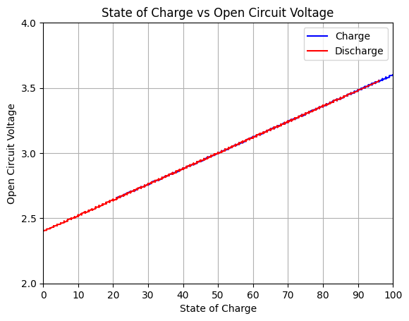
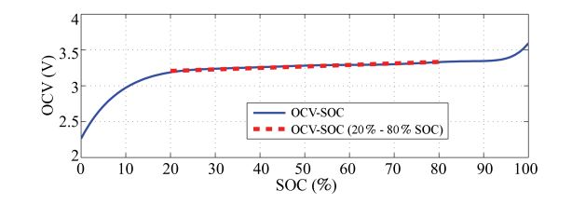
SOC Estimation Cont.,
Fig 11 : OCV - SOC Estimation
Using the input parameters such as voltage measured, current measured, and internal resistance, the reference SOC has been estimated.
OCV is the true “electro chemical” indicator of SOC. Estimating OCV is equivalent to estimating SOC. [4]

Slide 15
A123 Pre-processed Dataset – 30deg Profile
A123-18650 Li-ion battery is run through two different profiles (low current and dynamic) at 30°C temperature.
Input Features
Current | Voltage | Temperature | SOC
1.099941 | 2.82641 | 31.87122 | 36
1.100317 | 2.879962 | 31.82728 | 41
1.099941 | 2.921204 | 31.82728 | 44
1.100129 | 2.955368 | 31.82728 | 47
1.100129 | 2.984606 | 31.78333 | 50
SOC
Current
Temperature
Voltage
Table 5 : A123 LIB Dataset
Target Feature
Fig 12 : Input & Target Feature

Slide 16
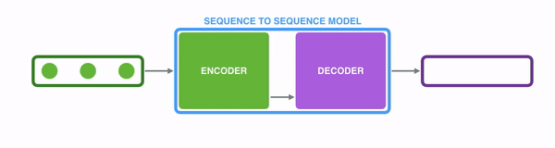
Sequence-to-Sequence (Seq2Seq) Network
A sequence-to-sequence network can be applied to state of charge (SOC) estimation by taking a sequence of past input values as (encoder), encoding them into a fixed-size context vector, and then decoding this vector into a sequence of future SOC values (decoder).
This allows the model to capture temporal dependencies and predict future SOC values based on historical data, which is essential for accurate SOC estimation in applications such as battery management systems.
Input
Output

Slide 17




Sequence to Sequence Architecture
Inputs
Encoder: Compresses input data into a latent space representation using a Multilayer Perceptron (MLP) architecture. Consists of densely connected layers with 16, 32, and 64 neurons, each utilizing the hyperbolic tangent (tanh) activation function. Ends with a Flatten layer to convert the output into a 1D array.
Context Vector: The compressed representation learned by the encoder is repeated and serves as the input for the decoder.
Decoder: Reconstructs the original input from the context vector. Composed of three Gated Recurrent Unit (GRU) layers with 64, 32, and 16 units, respectively. Each GRU layer uses the sigmoid activation function. The final Time Distributed layer with a Dense layer having 1 neuron and a linear activation function outputs the SOC.
Current Voltage Temperature
Encoder
MLP
Seq2Seq Network
GRU
Decoder
Target
State-of-Charge

Slide 18
Advantages over Base paper Model
Long/Short Term Memory (LSTM)
Efficient Parallelism: Using an MLP for encoding in state-of-charge prediction enables parallel computations, speeding up processing for real-time predictions and scalability.
Generalization with Reduced Overfitting: GRU-based decoding enhances feature extraction while reducing overfitting risks, ensuring accurate predictions across diverse battery conditions.
Compact and Streamlined: The combination of MLP and GRU architectures creates a compact model suitable for onboard battery management, optimizing resource utilization for deployment in electric vehicles and portable devices.
Input Hidden Layers Output
Gated Recurrent Unit (GRU)
Input Hidden Layers Output
- Cell memory - Gated memory

Slide 19
Results and Discussion
Comparison of Performance Metrics of the Proposed Model
Sequence to Sequence Model (%)
Metrics | N10deg | 10deg | 25deg | 30deg | 40deg
MSE | 0.1139 | 0.0847 | 0.0889 | 0.0880 | 0.0877
RMSE | 0.3375 | 0.2911 | 0.2982 | 0.2967 | 0.2961
MAE | 0.2783 | 0.2512 | 0.2549 | 0.2547 | 0.2528
MAPE | 0.8687 | 0.4859 | 0.4567 | 0.4735 | 0.4492
Table 6
Fig 13
Metrics like MSE, RMSE, MAE, and MAPE offer quantitative measures to assess model performance. Lower values indicate better accuracy for MSE, RMSE, and MAE, while MAPE provides a percentage-based perspective on prediction errors. Analyzing these metrics collectively helps gauge the model's effectiveness and identify areas for enhancement.

Slide 20
Results and Discussion
Fig 14 : Results Comparison with Base Paper

Slide 21
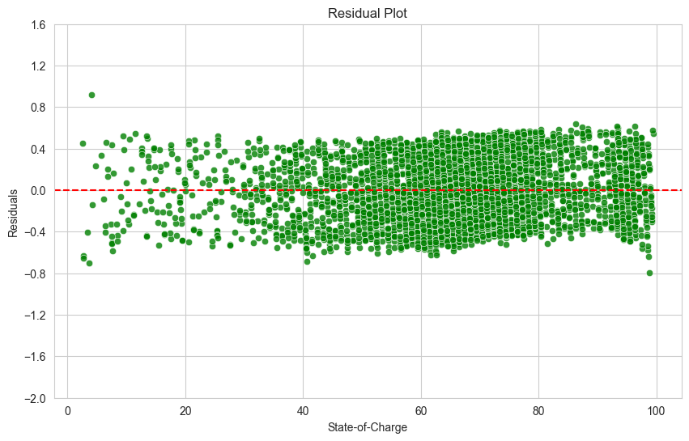
Conclusion
In conclusion, our state-of-charge (SOC) prediction model, employing a Multilayer Perceptron (MLP) for encoding and Gated Recurrent Unit (GRU) for decoding, stands out for its efficient parallel processing and enhanced feature extraction capabilities.
Furthermore, we've implemented a user-friendly SOC prediction system using Tkinter, ensuring accurate forecasts for various battery conditions. With its robust architecture and user-friendly interface, our model promises to drive innovation in battery management and contribute to the advancement of energy-efficient technologies.
Fig 15 : Residual Plot of 30deg
Fig 16 : Training CT (Mins)

Slide 22
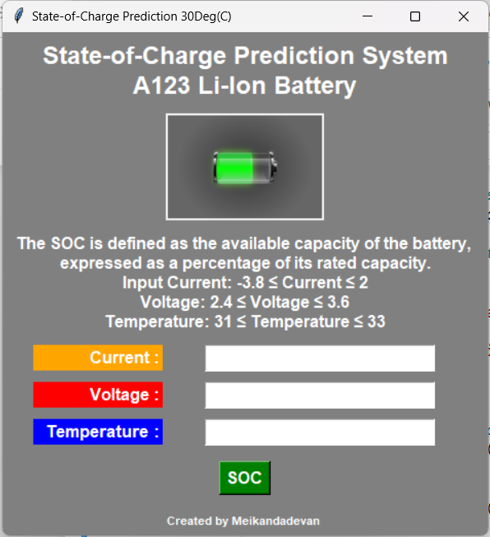
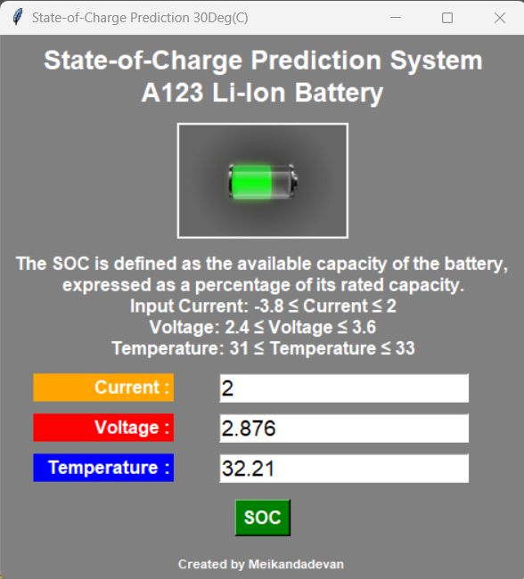
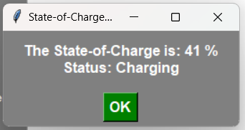
Model Deployment
Fig 17 : Model Deployment

Slide 23
Workplan
Domain & Base paper selection
Dataset Collection
Evaluating the Model
Project Completion
15-Jan-2024
20-Feb-2024
20-Mar-2024
1-Jan-2024
1-Feb-2024
15-Mar-2024
20-Apr-2024
Literature Survey
Data Driven Model Building
GUI & Report Generating

Slide 24
References
[1] Y. Huang, J. Sun, L. Xu, "A multi-variable multi-step Seq2seq network for the state of charge estimation of lithium-ion battery," Case Studies in Thermal Engineering, vol. 51, pp. 103566, November 2023. https://doi.org/10.1016/j.csite.2023.103566.
[2] Y. Tian, R. Lai, X. Li, J. Tian, "State-of-charge estimation for lithium-ion batteries based on attentional sequence-to-sequence architecture," Journal of Energy Storage, vol. 62, pp. 106836, June 2023. https://doi.org/10.1016/j.est.2023.106836.
[3] F. Yang, X. Song, F. Xu, and K.-L. Tsui, "State-of-Charge Estimation of Lithium-Ion Batteries via Long Short-Term Memory Network," IEEE ,vol.7,pp.53792-53799,2019. https://doi.org/10.1109/ACCESS.2019.2912803.
[4] Quan‑Qing Yu1, Rui Xiong1, Le‑Yi Wang2 and Cheng Lin, “A Comparative Study on Open Circuit Voltage Models for Lithium-ion Batteries,” Chinese Journal of Mechanical Engineering, pp.31-65,2018.
https://doi.org/10.1186/s10033-018-0268-8.
[5] Zhong Ren, Changqing Du, “A review of machine learning state-of-charge and state-of-health estimation algorithms for lithium-ion batteries,” Energy Reports, vol.9,pp.2993-3021,2023.
https://doi.org/10.1016/j.egyr.2023.01.108.

Slide 25

Thank You

